Slide 1





AI-POWERED PERSONAL TUTOR:
A Scalable, Adaptive Learning System for Enhanced Student Engagementaph
By.
KARINA SEBASTIAN
ASHWINI SR
PROBLEM STATEMENT: 3
CHRIST(DEEMED TO BE UNIVERSITY)

Slide 2

PROBLEM STATEMENT
This project addresses four key challenges:
Prediction of Assessment Scores: Accurately forecasting student performance by analyzing academic and behavioral factors to decide promotion readiness.
Selective Content Filtering: Identifying and omitting unnecessary topics for each learner level to avoid overload and personalize learning.
Recommendation of Teaching Material: Matching content difficulty to a student's level to ensure relevance and engagement.
Dynamic Content Curation: Leveraging LLMs and Retrieval-Augmented Generation (RAG) to generate adaptive and level-appropriate
learning content in real time.

Slide 3

TASK-1 STUDENT PROMOTION PREDICTION
Built a Random Forest Classifier model achieving 96% accuracy in predicting whether students should be promoted or retained.
Tuned hyperparameters for optimal performance and handled class imbalance via techniques like SMOTE.

Slide 4
TASK 2 &3 STUDENT CLUSTERING &PREDICTING SUITABLE COURSE/MATERIAL
TASK 2 – STUDENT CLUSTERING:
Performed K-Means Clustering to group students based on learning patterns, engagement, and assessment scores.
Used Elbow Method and Silhouette Score for optimal cluster determination.
Task 3 – Predicting Suitable Course/Material:
Applied PCA (Principal Component Analysis) for dimensionality reduction and visualization of student segments.
Used the clusters to map and suggest appropriate personalized content, ensuring each student received tailored resources based on their proficiency level.

Slide 5
TASK- 4 CURATING TEACHING MATERIAL DYNAMICALLY (RAG + LLM)
STUDENT ACTIVITY (e.g., new test/subject), using input metrics like IQ, score, and learning level.
Query formulated in natural language using student metadata to guide personalized content generation.
RAG pipeline retrieves top educational snippets from sources like NCERT.
LLM (e.g., GPT) generates level-appropriate content (simple explanations, analogies, visuals, questions).
CONTENT MAPPED TO STUDENT LEVEL: Beginner, Intermediate, Advanced with difficulty scaling (Easy to Hard).
INBUILT DICTIONARY: This tool allows the students to double-click any challenging term within the carefully curated content and see its definition immediately through a pop-up.

Slide 6
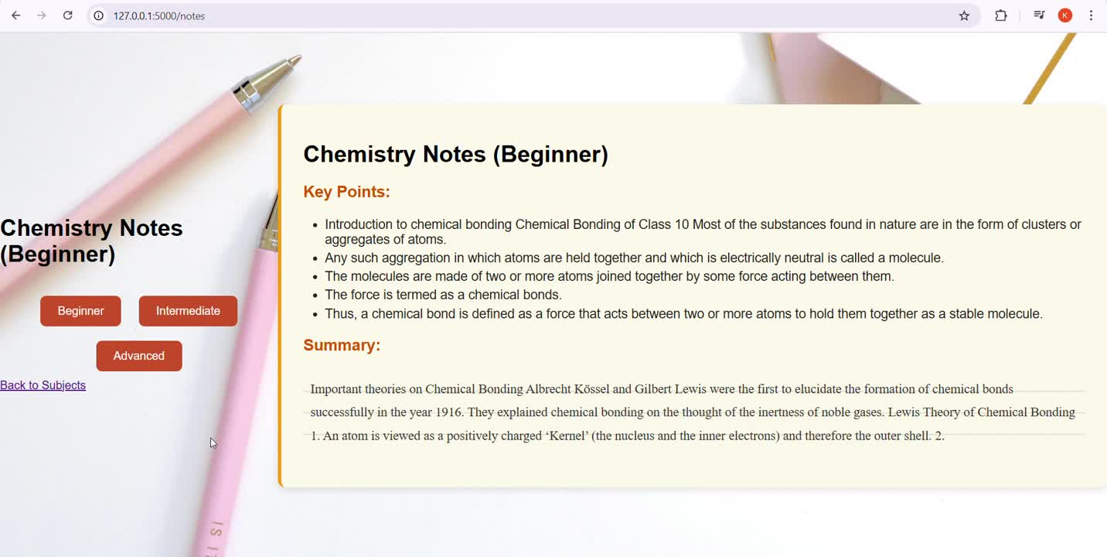
TASK- 4 INTEGRATED WITH UI

Slide 7
SUMMARY
Task 1: Student Promotion Prediction
Used Random Forest Classifier to predict student promotion with 96% accuracy.
Input features included assessment scores, participation, IQ, and course level.
Task 2: Intelligent Content Skipping
Predicted which topics a student could skip based on past performance and engagement.
Ensured time-efficient learning without compromising concept mastery.
Task 3: Next Topic Prediction
Applied K-Means Clustering + PCA to group students and predict the next suitable topic.
Enabled personalized learning paths and optimized concept flow.
Task 4: Dynamic Teaching Material Curation
Leveraged RAG + LLM to create real-time, level-appropriate content.
Delivered content tailored to student IQ, age, and test scores using semantic search and generation.

Slide 8

CONCLUSION
The AI-Powered Personalized Tutor System for K-12 students is an all-inclusive and intelligent solution that meets the varied learning requirements of students of different ages and academic standards. Through the use of advanced machine learning models, retrieval-augmented generation (RAG), and large language models (LLMs), the system is able to efficiently automate four crucial tasks — forecasting student promotion, adjusting content difficulty according to the levels of the students, suggesting appropriate course material, and dynamically creating teaching content for improved understanding.

Slide 9
THANKYOU!

